Slide 1
Welcome
Volunteer support in IPEM
Eva McClean, EDI and Member Networks Manager
6 November 2024

Slide 2

Volunteer policies, information and support
All resources can be found on ipem.ac.uk/volunteer/
Volunteer guide for key points
Relevant policies
Insurance and expense payments
What to do if you need to take a break
Key contacts and office support
Source: CRM @ 7th June 2022

Slide 3

IPEM achieved Investing in Volunteers standard award
This is a framework to assess the quality of how we
engage and work with volunteers.
Volunteers increasingly busy so we want to:
Give you the support you need to do your role
Ensure you have a good volunteer experience
Maximise the effectiveness of the time, professional input and impact you provide to IPEM.
Source: CRM @ 7th June 2022

Slide 4
National office team to support you
Every committee has a dedicated member of staff
More specialist support (more from my colleagues later)
Policy / Impact / Communications
Workforce / Professional knowledge
Education / Training / Accreditation / Registration
Publications / Task & Finish groups
Conferences / Finance
Membership / EDI
Source: CRM @ 7th June 2022

Slide 5
Volunteer Survey 2024 – highlights
Only 8% said that the role was as not as they expected (better than the 13% in 2022)
Only 13% didn’t receive a welcome information / induction. (better than the 20% in 2022)
86% felt that they got enough support from the office (improved from 74% in 2022)
Over 91% found application process Very Easy or Easy
Source: CRM @ 7th June 2022

Slide 6
Volunteer Survey – Satisfaction with volunteering
Almost 90 % said their volunteering work had a Lot or Some Impact.
Only 1% said they would definitely not volunteer again and 4% were very dissatisfied.
But 80% said they were satisfied or very satisfied with the experience and very likely to volunteer again.
82% felt Very or Somewhat Appreciated by IPEM
Source: CRM @ 7th June 2022

Slide 7
Thank you

Slide 8
Professional Knowledge & Innovation
Jen Cannon, Professional Knowledge and Innovation Manager

Slide 9
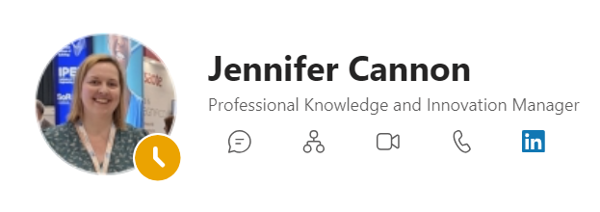
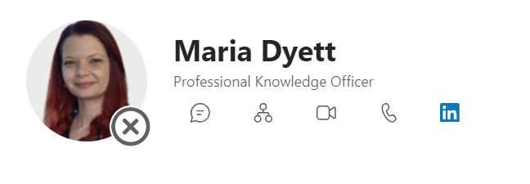
Areas of operation

Slide 10
Areas of operation
Leading on IPEM’s Science Leadership Strategy, encouraging this to be embedded within IPEM’s volunteer activity
  Developing an update to IPEM’s Science Leadership Strategy
Office manager of the Science, Technology, Engineering, Research and Innovation Council (STERIC)
Manager of outputs and activities for AI Group and Environmental Sustainability Group
Prizes and Awards
Professional resources
Outreach
Task and Finish Groups

